Slide 1

Laurea in ingegneria dell’automazione
Progetto di un emulatore di encoder incrementali per applicazioni ferroviarie
Supervisor
Prof. Tullio Salmon Cinotti
Co-Supervisor
Ing. Kristian Bandi
Tesi in reti logiche
Presented by
Samuele Pilati

Slide 2

Contenuti
Incremental encoder
Project
Technologies
GUI
Problems and solutions
Results
Demo
Attuale icona del GITSIM

Slide 3
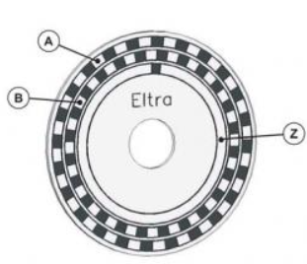
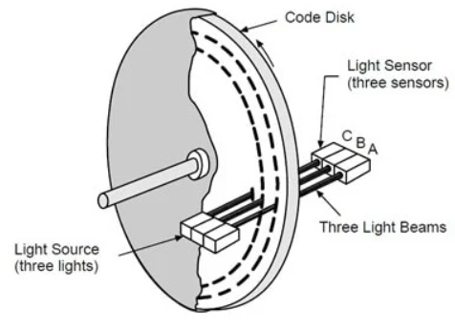
Incremental encoder
An encoder is an electronic device used to convert mechanical motion into electronic signals.
Optical encoders use a perforated disk or a grid of lines to generate pulses in response to motion.
Compared to other position transducers, encoders offer several advantages: they provide extremely precise position and speed readings, are highly reliable, and their non-contact nature makes them less prone to wear than traditional electronic devices.
The electronic signals produced by the encoders are then interpreted by an electronic component known as an odometry to obtain values ​​for relative position, speed, and acceleration.

Slide 4
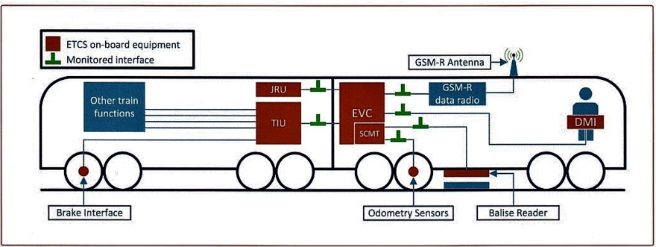

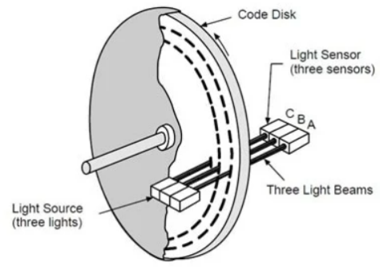
Project: Incremental encoder emulator realized with FPGA
The goal of this project was to create a device capable of emulating incremental encoders, allowing for the testing of odometry systems—and the algorithms used within them—in a laboratory setting rather than in the field.
This device has been called GITSIM.
The GITSIM should generate the same signals that would come from the sensor shown in the image above.
Segnale A
GITSIM
Segnale B

Slide 5
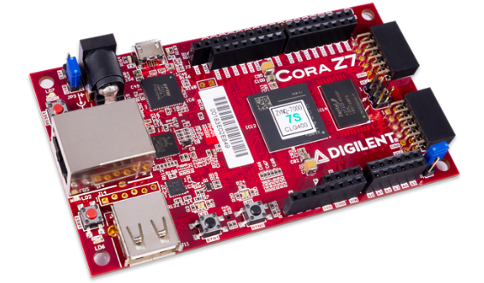
Project: Incremental encoder emulator realized with FPGA
For this thesis project, an incremental encoder emulator was implemented on the Cora-Z7 board, manufactured by Digilent.
The device, called GITSIM, is capable of simulating 3 encoders simultaneously and displaying encoder characteristics—such as speed, generated pulses, and distance traveled—in real time.
To boost performance, a portion of the project was implemented in an FPGA.
The graphical interface was developed in Python to ensure lower RAM usage compared to one developed in MATLAB.

Slide 6
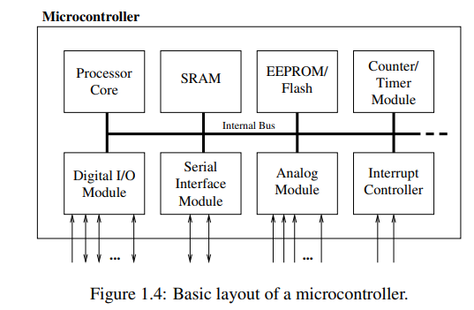
Microcontrollor and SoC (System on Chip)
A microcontroller is a processor equipped with memory, timers, ADC and DAC converters, I/O (parallel) pins, and other peripherals—all on a single chip.
This solution helps reduce development and production costs, while also offering other advantages such as ease of updating, lower energy consumption, and greater reliability compared to a solution where the components are not integrated into a single chip.

Slide 7
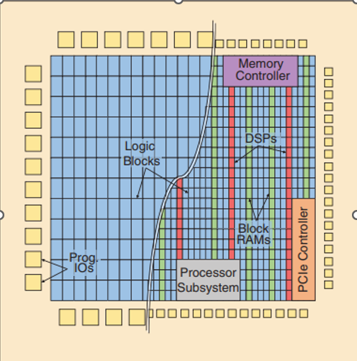
FPGA
FPGAs (Field-Programmable Gate Arrays) are reconfigurable computer chips that can be programmed to implement any digital hardware circuit.
FPGAs consist of an array of various types of programmable blocks (logic, I/O, and others) that can be flexibly interconnected via pre-fabricated routing paths with programmable switches between them.

Slide 8
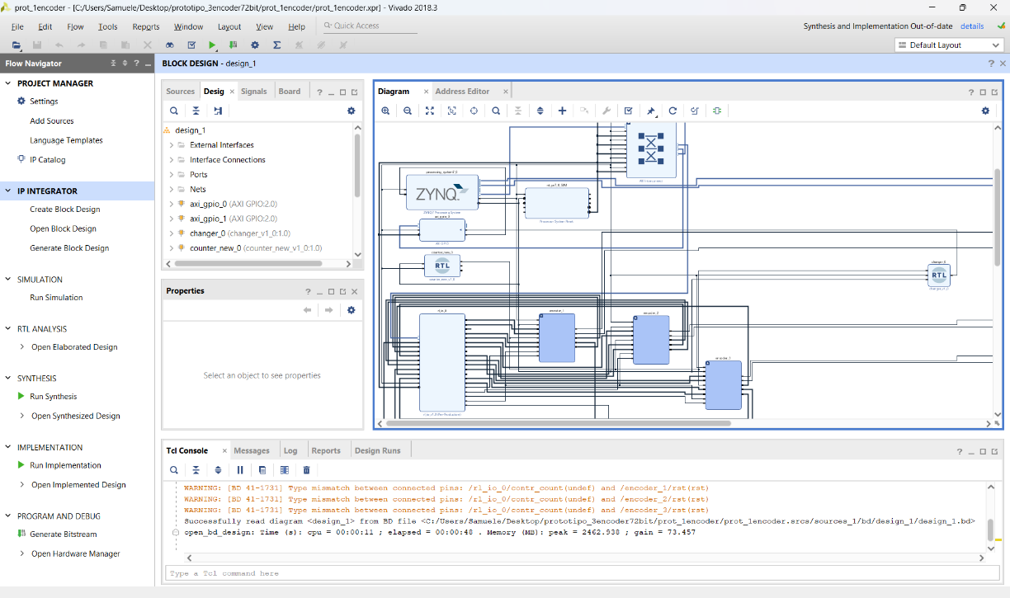
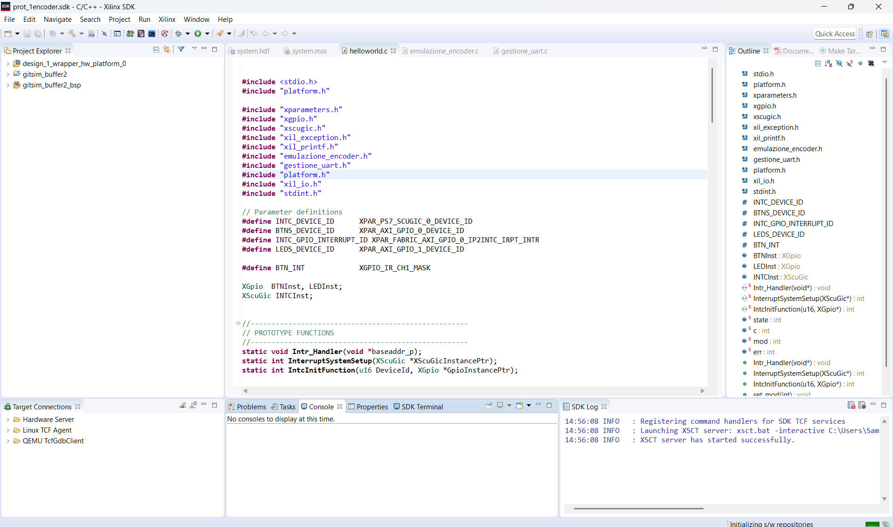
Project: Vivado and SDK
For the development of this project, Vivado and SDK—two software programs provided free of charge by Xilinx (now AMD)—were used for a specific range of boards, including the Cora Z7 (the board used for this project).
Vivado grafical interface
SDK grafical interface(based on eclipse)

Slide 9
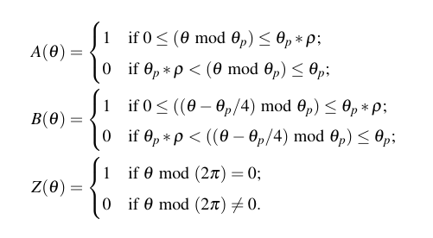


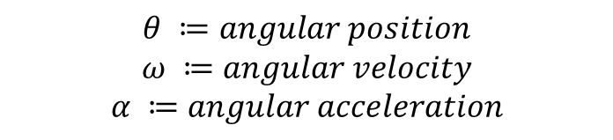
Project: division of tasks between FPGA and
firmware
In the project, the formulas listed on the right, which describe the behavior of an encoder, were implemented on an FPGA, achieving a pulse-generation resolution of 50 MHz.
The tasks of exchanging messages with the GUI (i.e., the personal computer of the device user) and initializing all the components used have been implemented in firmware, which also serves as an intermediary between the GUI and the FPGA.
Equations that describe incremental encoder
Equations that describe the relationship between angular velocity and position, and between angular acceleration and angular velocity.
$$θ ≔angular position$$
$$ω ≔angular velocity$$
$$α ≔angular acceleration$$
$$ρ ≔duty cicle θ_{p} ≔distance traveled per step$$

Slide 10
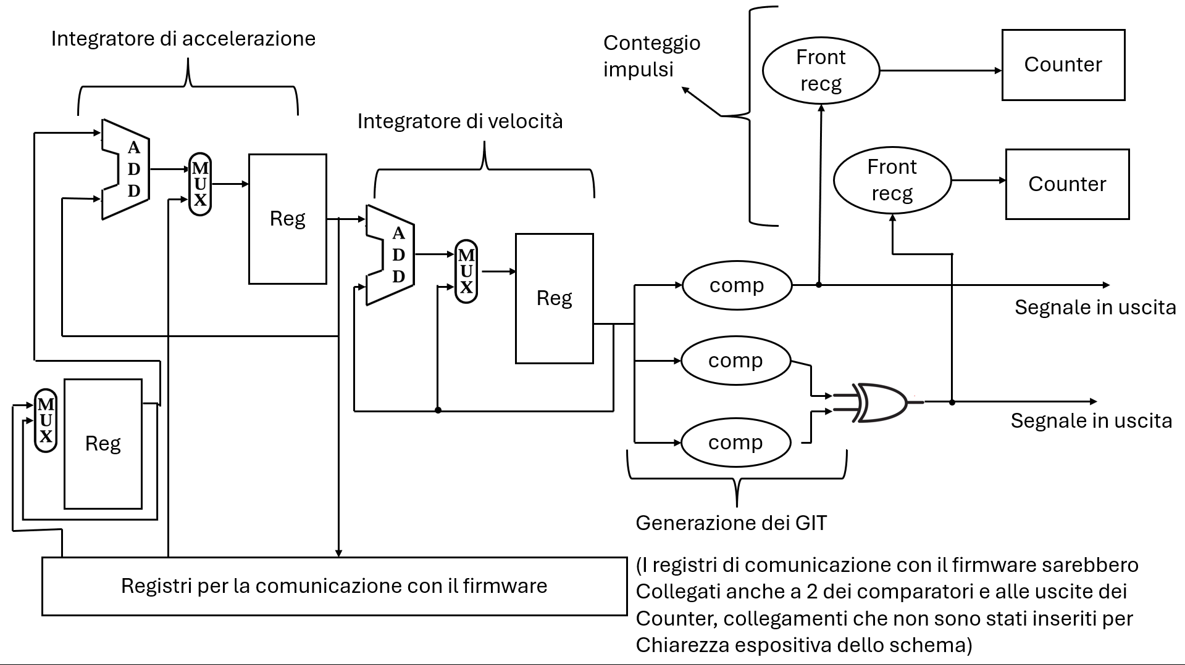
Circuit implemented in FPGA
Design of the logic scheme implemented in an FPGA
(Some are in italian)

Slide 11
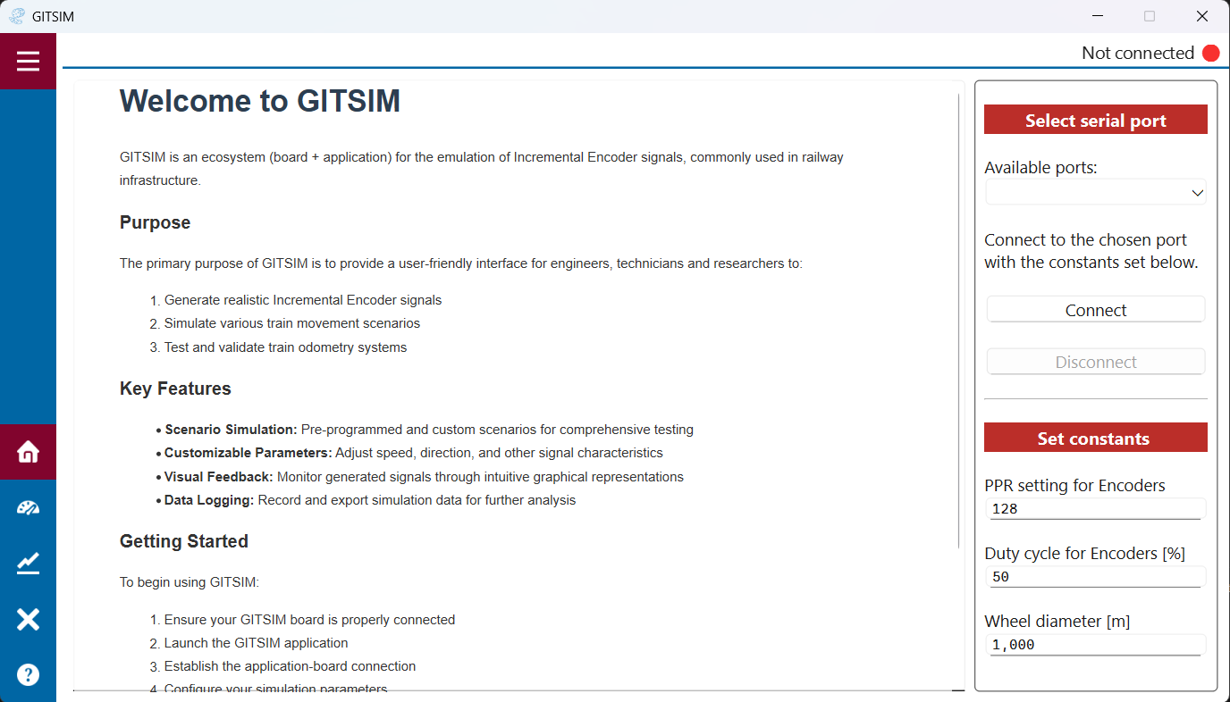
GUI: Home
The home screen allows the user to select the port to which the device is connected, to connect and disconnect, and to enter the parameters for the encoder-wheel assembly.

Slide 12
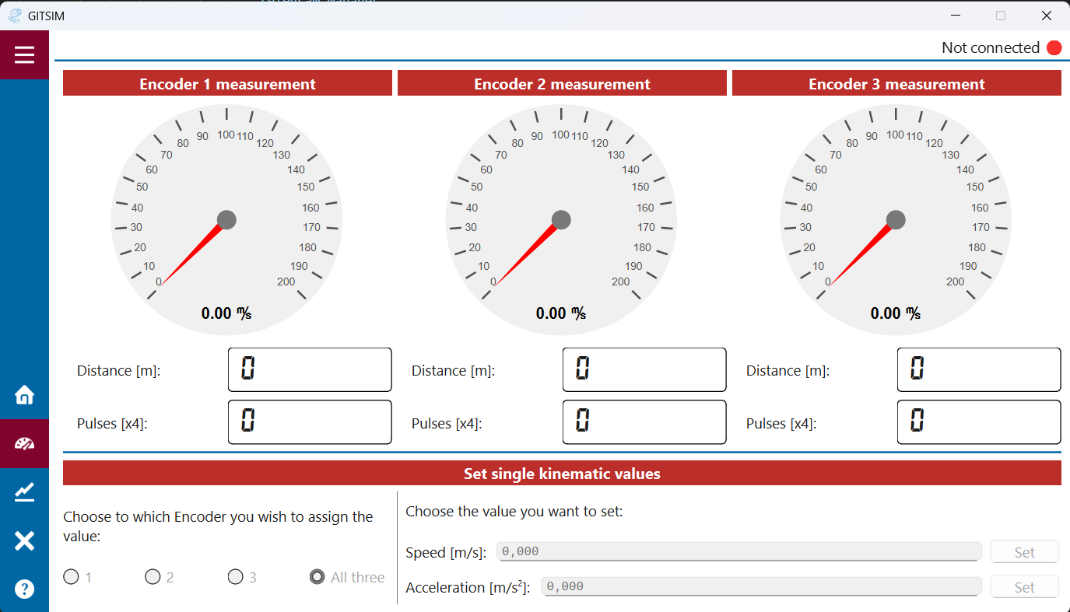
GUI: Measurament
This page allows you to run simple simulations by entering the desired velocity or acceleration values.
Information from the encoders is also displayed (speed, distance traveled, and pulses generated).
You can choose which encoder to simulate using the buttons in the bottom-left corner.
By default, speed and acceleration are set to 0.

Slide 13
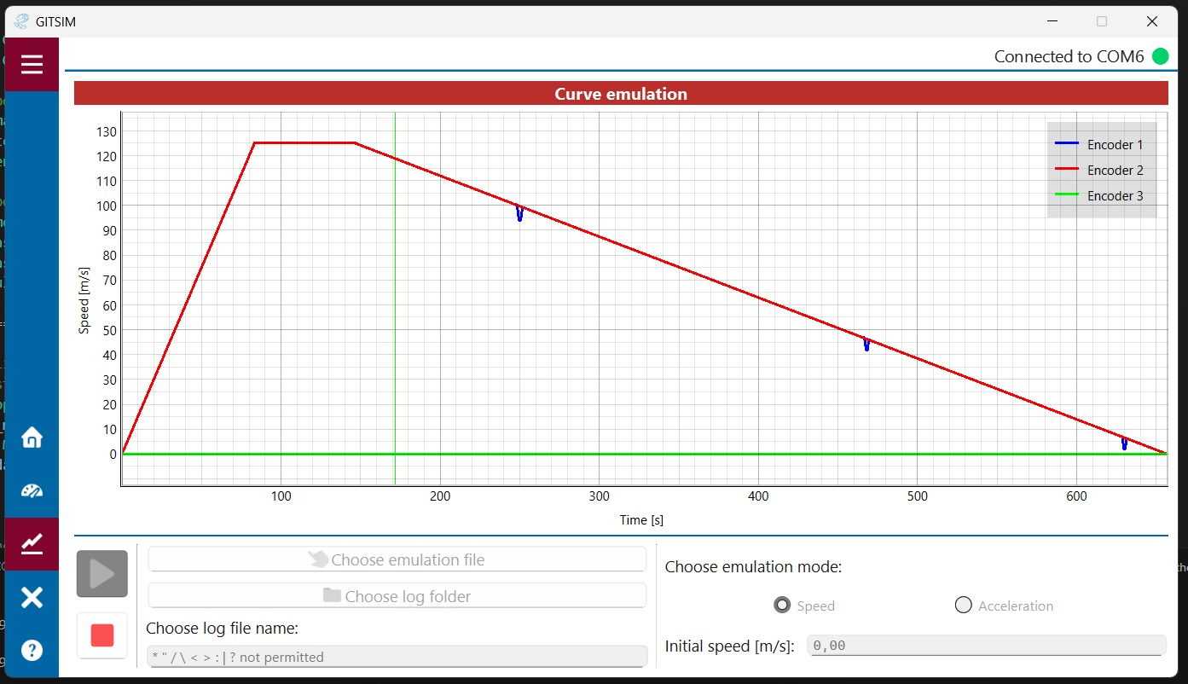
GUI: Curve emulation
This page allows you to simulate encoders by inputting velocity or acceleration trajectories (e.g., via an Excel file).
The trajectories are displayed on the screen; the vertical green line indicates our current position within the simulation.
Encoder information can be viewed on the Measurement page, even while a simulation is running.

Slide 14
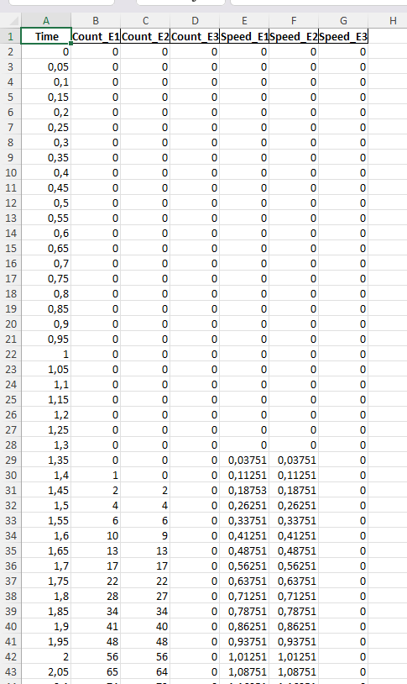
Example of log:
When a trajectory is simulated, a log file (an Excel table) is created, containing the velocity and pulse values ​​generated by the three encoders.
These values ​​are updated every 50 milliseconds.
The data recorded in the log is measured directly by the FPGA and then sent to the GUI.

Slide 15
Problems solutions:
Implementations of buffer to avoid loss of messages
The GUI and GITSIM exchange messages using the following protocol: every 50 milliseconds, GITSIM sends a message to the GUI containing information on the speed and pulses generated. Upon receiving this message, the GUI should immediately respond with a message containing instructions for GITSIM.
To avoid issues that may arise from a lack of synchronization of messages between GITSIM and the GUI, input and output buffers have been added to GITSIM.

Slide 16
Results
The following slides will show the results obtained by simulating several typical velocity and acceleration profiles.
All distance values ​​presented are expressed in meters.
In the tests that follow, a comparison is made between the number of fronts predicted, the number of fronts generated by the emulator, and the number of fronts detected by the odometry system.
Emulation data(velocity or acceleration)
Generated impulses
(3different encoders)
Geometric profile
Eumlator of impulses (GITSIM)
Odometry on train
Teoretical impulses
Impulses generated from GITSIM
Impulses read from odometry

Slide 17
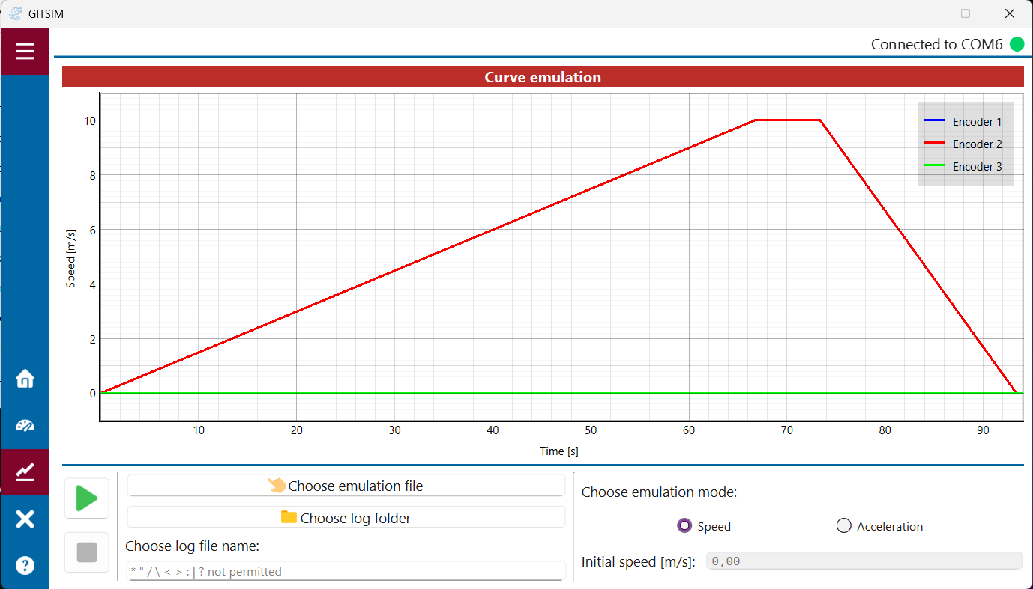
Risultati:
Profilo n.1
Tratta di 500 metri percorsa a velocità lenta
Accelerazione e decelerazione costante con velocità massima 10 metri al secondo.
 | Teorici | Generati e riportati via GITSIM | Odometria
Impulsi | 81487 | 81487 | 81487
Distanza percorsa(m) | 500 | 499,997 | 500,004

Slide 18
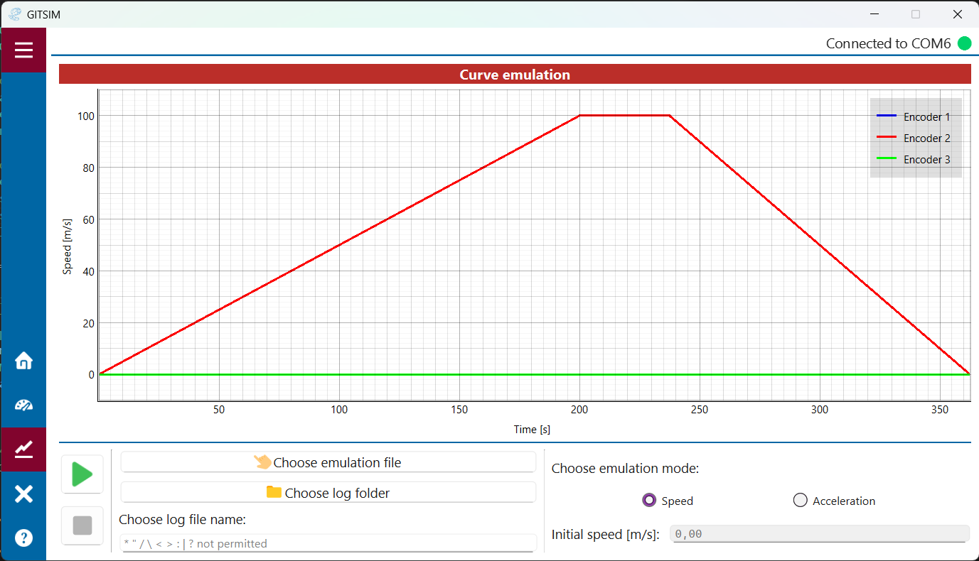
Risultati:
Profilo n.2
Tratta di 20 km con velocità massima di 360 km/h
Accelerazione e decelerazione( 0,5m/s² e -0,8m/s²⁾ costante con velocità massima 100 metri al secondo.
 | Teorici | Generati e riportati via GITSIM | Odometria
Impulsi | 3’259’493 | 3259498 | 3259499
Distanza percorsa | 20’000 | 20’000,03 | 20’000,038

Slide 19
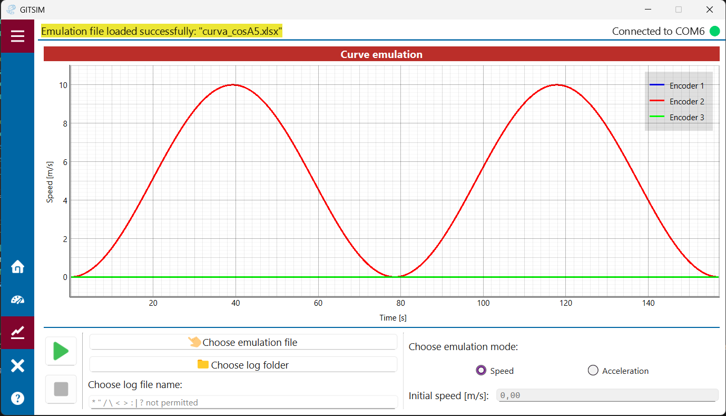
Risultati:
Profilo n.3
Velocità con forma sinusoidale
 | Teorici | Generati e riportati via GITSIM | Odometria
Impulsi | 128000 | 128000 | 128000
Distanza percorsa | 785,40 | 785,40 | 785,43

Slide 20
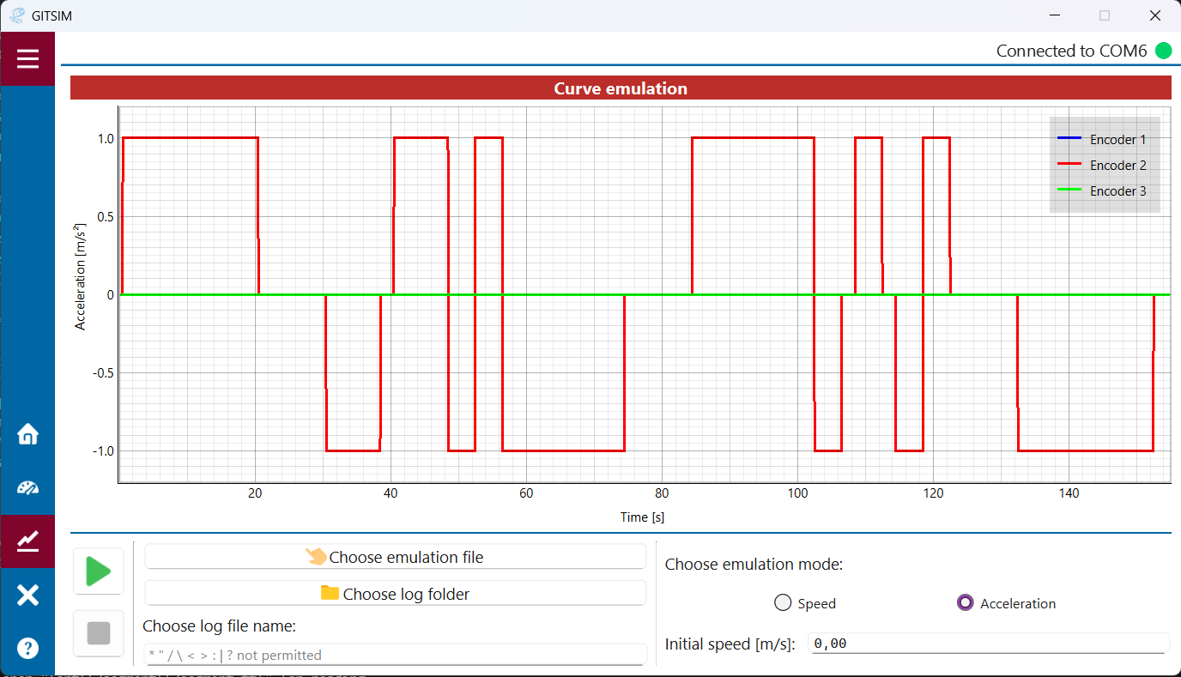
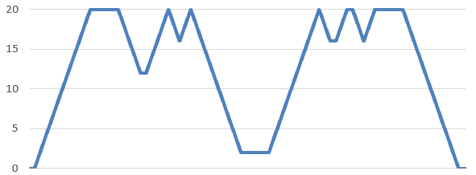
Risultati:
Profilo n.4
(es. di ingresso a strappi in grande stazione)
Curva «Ricciardi» 1m/s^2
Profilo di velocità della curva
 | Teorici | Generati e riportati via GITSIM | Odometria
Impulsi | 325949 | 325950 | 325950
Distanza percorsa | 2000 | 2000,002 | 2000,01

Slide 21
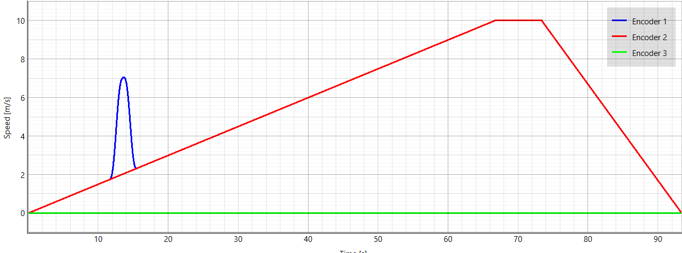
Risultati:
Profilo n.5
Caso di slittamento di una delle ruote simulate
Una delle applicazioni di questo dispositivo è poter testare algoritmi delle odometrie usati per rilevare situazioni di slittamento o pattinamento
 | Teorici | Generati e riportati via GITSIM | Odometria
Impulsi git 1 | 83117 | 83117 | 83117
Impulsi git 2 | 81487 | 81487 | 81487
Distanza percorsa git 1 | 510 | 509,999 | 510,008
Distanza percorsa git 2 | 500 | 499,997 | 500,005
Distanza calcolata dall’algoritmo |  |  | 500,190

Slide 22
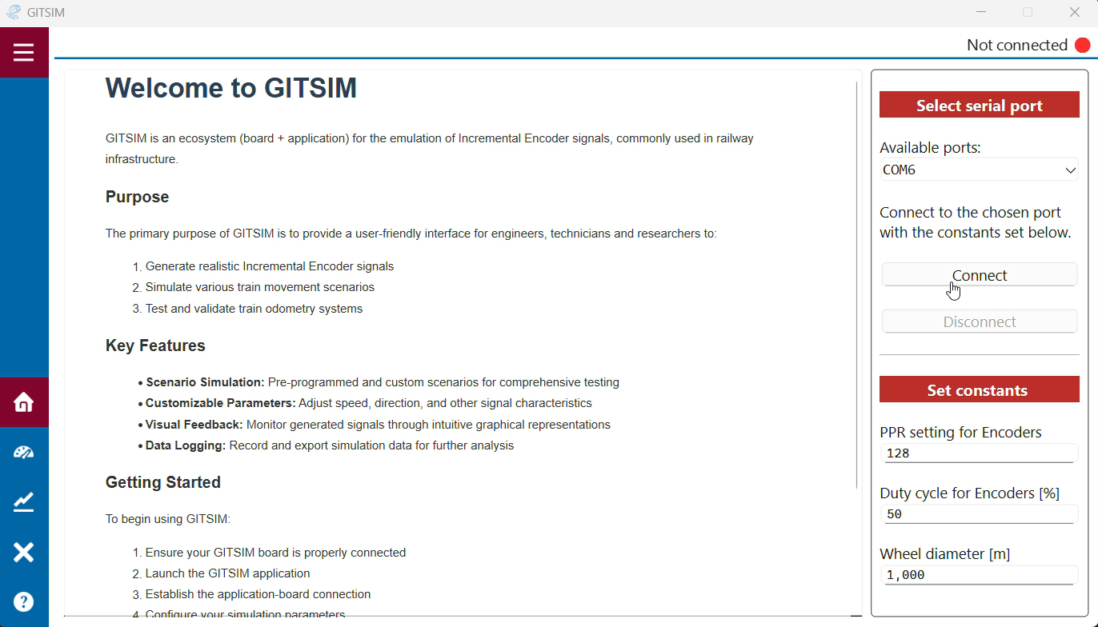
Demo

Slide 23
Grazie per l’attenzione

